Slide 1
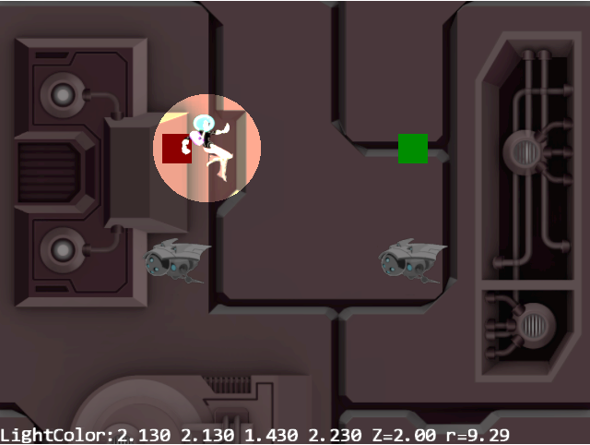
Volume of Illumination
Point Light
Z = 10
Z
Z = 0
Y
X
Illuminated Circle

Slide 2
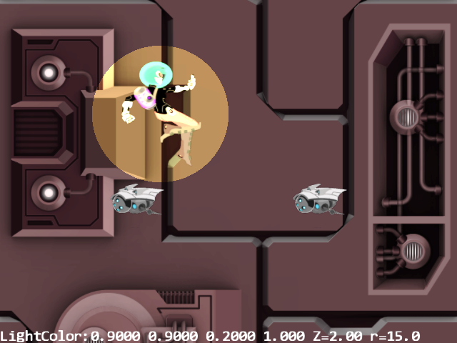
Volume of Illumination
Point Light
Z = 10
Z = 0
Z
Y
X
Illuminated Circle
Figure 8-2

Slide 3
Transform
Camera
vertexBuffer
texture
Light
Renderable
TextureRenderable
Game Engine
SpriteRenderable
SpriteAnimatedRenderable
LightRenderable
SimpleShader
TextureShader
SpriteShader
LightShader
TextureVS
per Vertex
from
SimpleVS
aTextureCoordinate
WebGL
LightFS
lightOn
per Pixel
from SimpleFS
position
color
from TextureFS
radius
Figure 8-3

Slide 4
Transform
Light
Renderable
mLights
(array of Light)
Game Engine
LightRenderable
SimpleShader
mShaderLights
(array of ShaderLightAtIndex)
LightShader
per Vertex
TextureVS
WebGL
LightFS
per Pixel
from SimpleFS
uLights
from TextureFS
Figure 8-5

Slide 5
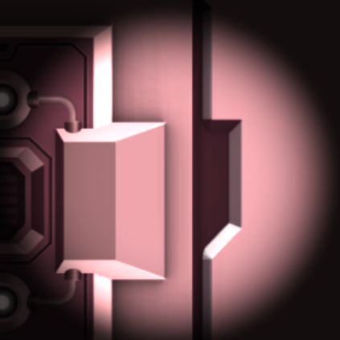
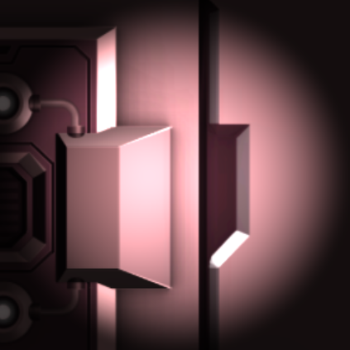
Approximated Position of Light
Approximated Position of Light
Vertical face behind the light being illuminated
Vertical face behind the light not being illuminated
Figure 8-7

Slide 6

$$\hat{N}$$
Surface
element
$\hat{N}$= Normal Vector
Object in 3D space
Figure 8-8

Slide 7
$$\hat{N}$$
$$\hat{L}$$
Light Source
A
$$\hat{N}$$
$$\hat{N}$$
$$\hat{L}$$
$$\hat{L}$$
C
B
Figure 8-9

Slide 8
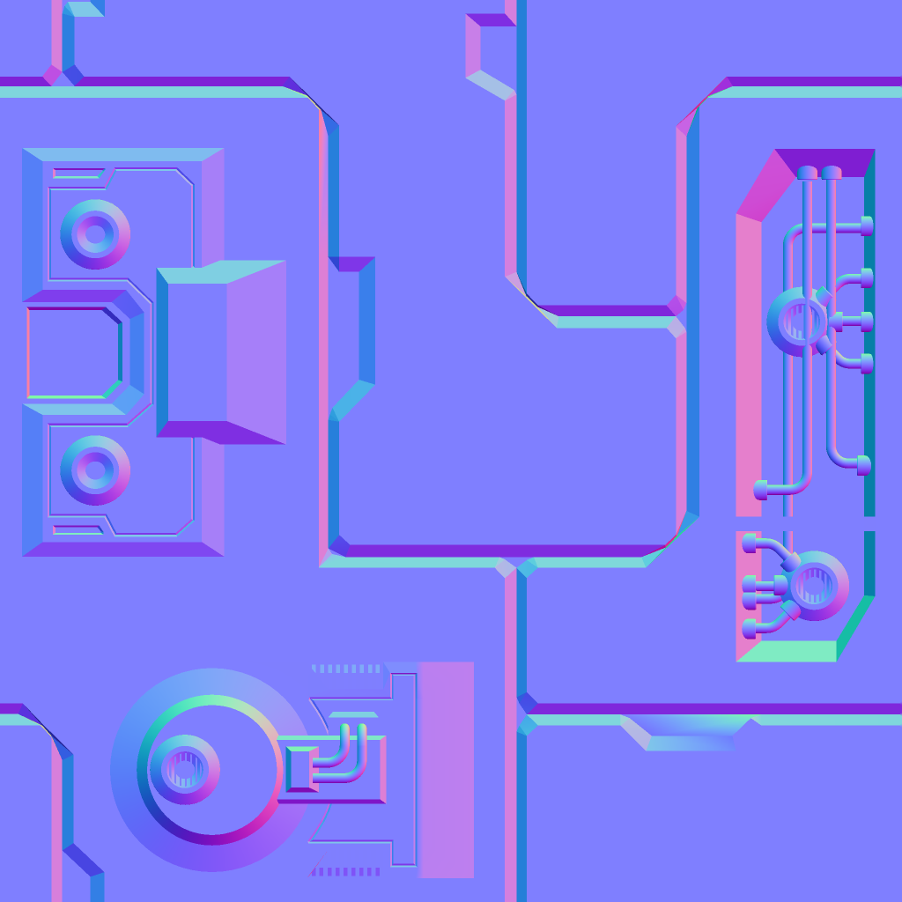
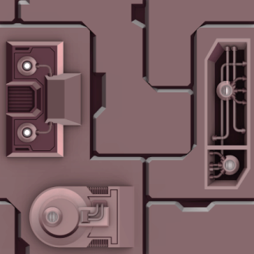

n₁
n₂
n₃
Normal texture
c₁
c₂
c₃
Color texture
eye
Figure 8-11

Slide 9
Perceived 3D contour
n₁
n₂
n₃
Normal texture
c₁
c₂
c₃
Color texture
Figure 8-12

Slide 10






$$\hat{N}$$
Light Source
eye
$$\hat{V}$$
$$\hat{L}$$
$$θ$$
$$θ$$
$\hat{N}$= Normal Vector
$\hat{V}$= View Vector
$\hat{L}$= Light Vector
Shiny Surface
Figure 8-14

Slide 11





A
$$\hat{V}$$
$$\hat{N}$$
$$\hat{R}$$
$$\hat{L}$$
B
$$α$$
$$\hat{V}$$
$$α$$
$$θ$$
$$θ$$
Specularity${∝\left(\hat{V}∙\hat{R}\right)}^{n}$
$\hat{R}$= Reflection of $\hat{L}$
n = Shininess
Figure 8-15

Slide 12



$$\hat{N}$$
$$\hat{H}=\frac{\hat{L}+\hat{V}}{2}$$
$$\hat{V}$$
$$β$$
$$\hat{L}$$
$$θ$$
$$θ$$
$\hat{H}$= Halfway Vector
Figure 8-17

Slide 13


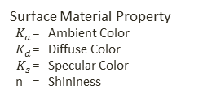


The Phong Illumination Model
$$C={K_{a}+I}_{a}C_{a}+I_{L}C_{L}K_{d}\left(\hat{N}∙\hat{L}\right)+{I_{L}C_{L}K}_{s}{\left(\hat{N}∙\hat{H}\right)}^{n}$$
Global Ambient Lighting ${ I}_{a}$ = Intensity (a float)
${ C}_{a}$= Light Color
$$\hat{V}$$
$$\hat{N}$$
$$\hat{H}$$
$$\hat{L}$$
Light Source
${ I}_{L}$ = Intensity (a float)
${ C}_{L}$= Light Color
$$θ$$
$$θ$$
Surface Material Property
$K_{a}$ = Ambient Color
$K_{d}$ = Diffuse Color
${ K}_{s}$ = Specular Color
n = Shininess
Figure 8-18

Slide 14
Transform
Light
Material
Renderable
LightRenderable
Game Engine
IllumRenderable
SimpleShader
LightShader
(Data type: ShaderMaterial)
IllumShader
mMaterialLoader
per Vertex
TextureVS
WebGL
IllumFS
per Pixel
uMaterial
Figure 8-19

Slide 15
Point Light
Directional Light
Spot Light

Slide 16
Light position
Light direction
Outer cone angle
Inner cone angle
Figure 8-21

Slide 17

Light.Position
lgtDir
Encoded by: cosL = lgtDir dot$\hat{L}$
Encoded by: lgt.CosInner
$$\hat{L}$$
eye
Encoded by: lgt.CosOuter
$$\hat{V}$$
Position to be illuminated
Figure 8-23

Slide 18

No Hero shadow on the background
Hero shadow on minion (Shadow caster geometry)
Hero causing the shadow (Shadow caster)
Minion receiving the shadow (Shadow receiver)
Figure 8-24

Slide 19
Light source
Hero (Shadow caster)
Shadow caster geometry
Minion (Shadow receiver)
Figure 8-25

Slide 20
Region should not be drawn
Light source
Shadow caster
Shadow caster geometry
Shadow receiver
Figure 8-26

Slide 21
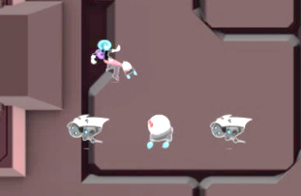
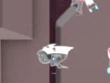
Original image
Stencil buffer
(on/off)
Results displayed in the canvas
Figure 8-27

Slide 22
Directional light
Point or spot light
Parallel projection
Projection from a point
Shadow caster
Shadow caster geometry
Shadow receiver
Figure 8-29

Slide 23




$$\hat{N}$$
Light Source
$$\hat{V}$$
$$\hat{H}$$
$\hat{N}$= Normal Vector
$$\hat{L}$$
$\hat{V}$= View Vector
$\hat{H}$= Halfway Vector
$\hat{L}$= Light Vector

Slide 24
Light source
Hero (Shadow caster)
Should not be drawn
Shadow geometry
Minion (Shadow receiver)
Background not receiving shadow

Slide 25





The Phong Illumination Model
$$I=k_{a}L_{a}+k_{d}L_{d}\left(\hat{N}∙\hat{L}\right)+k_{s}L_{s}{\left(\hat{N}∙\hat{H}\right)}^{n}$$
$$\hat{V}$$
$$\hat{N}$$
$$\hat{H}$$
$$\hat{N}∙\hat{L}$$
$$\hat{R}$$
$$\hat{L}$$
$\hat{N}$= Normal Vector
$$\hat{V}∙\hat{R}$$
$\hat{V}$= View Vector
$\hat{H}$= Halfway Vector
$\hat{L}$= Light Vector
$\hat{R}$= Reflection of $\hat{L}$

